Slide 1
Design pattern 1:
Creational: Singleton pattern
Context:
It is very common to find classes for which only one instance should exist(singleton).
Problem:
How do you ensure that it is never possible to create more than one instance of a Database class. And provide a global point of access to it.
Forces:
The use of a public constructor cannot guarantee that no more than one instance will be created.
The singleton instance must also be accessible to all classes that require it, therefore it must often be public.
Solution:

Slide 2
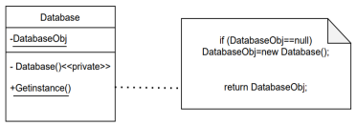
the constructor have to be private( Database() ) to ensure that no other class will be able to create an instance of the class singleton.
Define a public static method( getInstance()), The first time this method is called , it creates the single instance of the class Database and stores a reference to that object in a static private variable DatabaseObj.

